Slide 1
ISASI Military Tutorial
Multinational Military Mishap Investigation
Randall Sauer
21 August 2017

Slide 2
United States Marine Corps F/A-18
Transiting a USAFE base Redeploying
Crashes in NATO member host country
On private property
Who is in charge? Responsibilities?

Slide 3
Initial Response
USMC flight Lead contacted UK ATC, searching for missing wingman.
Reports of Aircraft down received by local authorities.
ATC enlisted an Aeromedical helicopter to assist in searching for aircraft. Found the primary site.
Cambridgeshire Fire and Rescue responded to site with two trucks.
RAF Mildenhall fire department was the first US response on scene.

Slide 4
Site Security
Local Police secured roads to site. Restricted access to local residents, farmers and those working the accident.
RAF controlled inner perimeter, logged everyone entering the site.
Entry control point to the crash site. Entry access list maintained by USAF Security Forces.
Patrolled inner perimeter.

Slide 5
Whose Investigation?
United Kingdom
Ministry of Defence
Defence Safety Authority
Military Aviation Authority
United States
Department of Defense
Naval Safety Center
United States Marine Corp

Slide 6
Key Players
USAF Interim Safety Board convened at RAF Lakenheath (DODI 6055.07, AFI 91-204)
Aircraft Mishap Board (OPNAVINST 3750.6)
Naval Safety Center, Norfolk (OPNAVINST 3750.6)
Naval Air Systems Command (OPNAVINST 3750.6)
Boeing Air Safety Investigator (PRO-626)
JAGMAN Investigation (JAGINST 5800.7)
NATO STANAG 3531
Defense Safety Authority – Defense Air Accident Investigation Branch

Slide 7
USAF Interim Safety Board
Directed by AFI 91-204 and AFPAM 91-223.
AFI 91-204 directs nearest AF installation to respond to a mishap involving DoD assets.
  Provide initial logistical, operational and investigative support
  Appoint an Interim Safety Board (ISB)
    USAF Interim Safety Board convened at RAF Lakenheath, 48th Fighter Wing
    ISB tasked to preserve evidence and gather factual data related to mishap until appointed investigative board is identified/arrives.
  Toxicology testing.
  Ensure the appropriate military notifications are
  accomplished.

Slide 8
USAF Interim Safety Board
ISB President or Investigating Officer will:
  Accept control of the wreckage and/or evidence.
  Initial collection and preservation of new evidence.
  Identify witnesses and conduct interviews.
  Gather factual data.
  Receive a briefing from the on-scene commander/incident commander/recovery operations chief (ROC) on all known hazards (including bloodborne pathogens) and personnel protective equipment requirements for the mishap site.

Slide 9
Naval Safety Center
Naval Safety Center Investigator:
  Provides on-site investigative expertise to mishap board.
  Refers mishap board to engineering and other technical assistance at material/systems command or equipment manufacturers.
  Controls disposition of physical evidence.

Slide 10
Aircraft Mishap Board
USMC Squadron standing AMB
  Members were on site as participants in redeployment operations.
  Aviation Safety Officer.
  Operations Officer.
  Flight Surgeon.
  Maintenance Officer.
Senior Member designated by aircraft controlling custodian.
Interim Safety Board handoff to AMB Senior Member 24 Oct.

Slide 11
Support to the AMB
48 Fighter Wing.
Military Air Accident Investigation Branch (MilAAIB).
F/A-18 Fleet Support Team (FST) Flight controls - NAS North Island, CA.
NAVAIRSYSCOM Mishap Investigation Support Team:
  On-site assessment of egress and survivability systems
  Ejection seat (Cherry Point, NC)
  Parachute, (China Lake , CA)
  Cartridge Actuated Devices, Propellant Actuated Devices (Indian Head, MD)
Boeing ASI – St Louis.
Joint Aircraft Recovery and Transportation Squadron (JARTS).
Mishap Investigation Support Team (MIST)

Slide 12
NATO STANAG 3531
Purpose: Establish procedures for safety investigations and reporting of accidents/incidents of military aircraft, missiles, and or UAV/UASs which involve the equipment, property, facilities and or personnel of two or more nations.
Nation of Occurrence: Nation on, or above whose territory or ship the accident occurred - United Kingdom.
Operating Nation: The nation which owns the military aircraft, missile or UAV/UAS involved in the accident /incident – United States.
Involved Nation: Any nation with direct ties to the situation – United Kingdom and the United States.
Nations of occurrence has overall responsibility for investigating Accidents/incidents of military aircraft (UK).

Slide 13
NATO STANAG 3531
When the mishap involves military acft and property from two or more nations, the responsibility for conducting the safety investigation is normally delegated to the operating nation (USA).
The nation of occurrence (UK) may provide an investigating group for appointment to the Safety Investigation Board as Members or Observers and/or may conduct a separate safety investigation at its sole discretion.
These options were not exercised by the UK.
USMC Aircraft Mishap Board to proceed with investigation.
The STANAG also has provisions for the nation of occurrence to provide an officer to provide liaison between the Safety Investigation Board and the civilian authorities of the nation of occurrence, and shall provide interpretation/translation services as required (Maj Turner from DAIB).

Slide 14
Military Air Accident Investigation Branch
The Military Aviation Authority is an independent organisation responsible for regulating air safety across defence.
Military Air Accident Investigation Branch (MilAAIB).
Agreement between Air Accident Investigation Branch (AAIB) and MoD (MilAAIB).
Resulted from Nimrod Review - established 2006.
Foreign Military Aircraft on UK territory.
Secure vulnerable and perishable evidence.
Observer status executed during this investigation.

Slide 15
Joint Aircraft Recovery and Transportation Sq
RAF & RN Personnel.
Only MoD organization dedicated to Aircraft Post-Crash Management, recovery and transportation.
4 Crash Teams at high readiness for all UK services.
Assist at civilian aircraft crash sites when requested by AAIB.

Slide 16
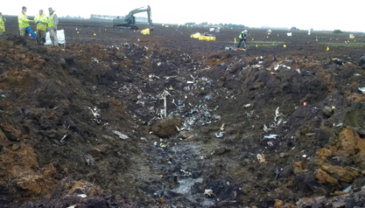
Joint Aircraft Recovery and Transportation Sq
JARTS personnel in charge of site recovery.
Preserved site until AMB convened on site. Worked with the AMB to recover evidence and preserve chain of custody.
Worked on the approval of and at the direction of the AMB.
Determined personal protective equipment requirements for personnel working on site.
Coordinated site remediation after site released by AMB.

Slide 17
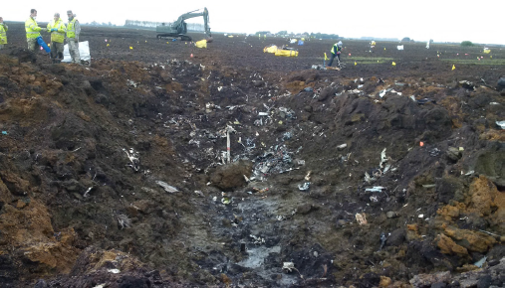
Joint Aircraft Recovery and Transportation Sqn
Larger parts, actuators, were identified and moved to a corner stake.
Parts at stakes were segregated from general debris.
Parts in each area were identified by the Bags.
USAF crash recovery personnel assisted JARTS team.
Hanger picture

Slide 18
48 Fighter Wing, Lakenheath
Wing Safety
  Secure location for AMB to work from.
  Coordinated for vehicles for AMB
  Computer network access and support
  Supplies
48th Operations Group
  Aerial Photographs from HH-60
48th Maintenance Group
  Crash recovery personnel
  Location for aircraft parts storage
48th Mission Support Group
  Force Support Sq personnel and augmentees for human remains recovery
  Security Forces
  Civil Engineering
    Explosive Ordinance Disposal
    Site Survey
  Photographs of crash site
48th Medical Group

Slide 19
Investigative Support USAF

Slide 20
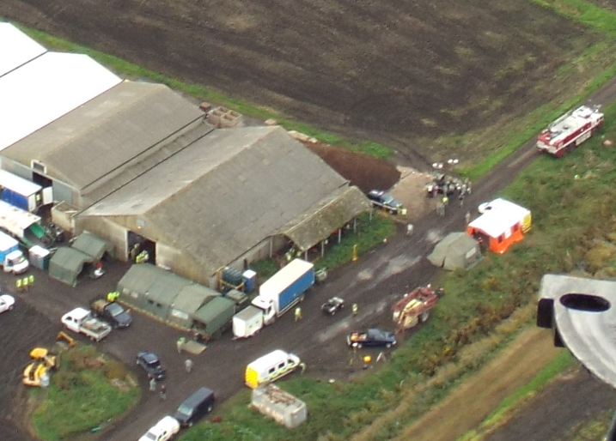
Investigative Support - RAF
3 Mobile Catering Squadron (3 MC Sqn) RAF Wittering as part of 85 (EL) Wg

Slide 21
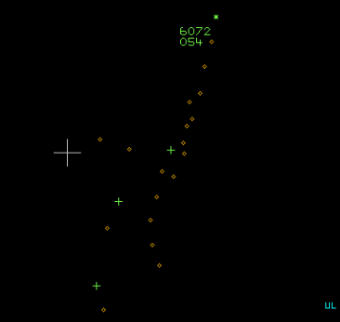
Investigative Support - RAF
RAF provided:
  Radar data from 3 stations.
  Air traffic control tapes.

Slide 22
Judge Advocate General
Black Hat Investigation
JAGMAN Investigation (JAGINST 5800.7).
  Death or serious injury,
  Extensive damage to (US) Government property, or
  Possibility of a claim exists against (US) Government.
Independent of the AMB.
Access to all real evidence and separate opportunity to question and obtain witnesses statements.
Produces a publicly releasable accident report.

Slide 23
Summary
Two Countries.
Six military services.
Numerous supporting agencies.
Complete a common goal.

